Slide 1
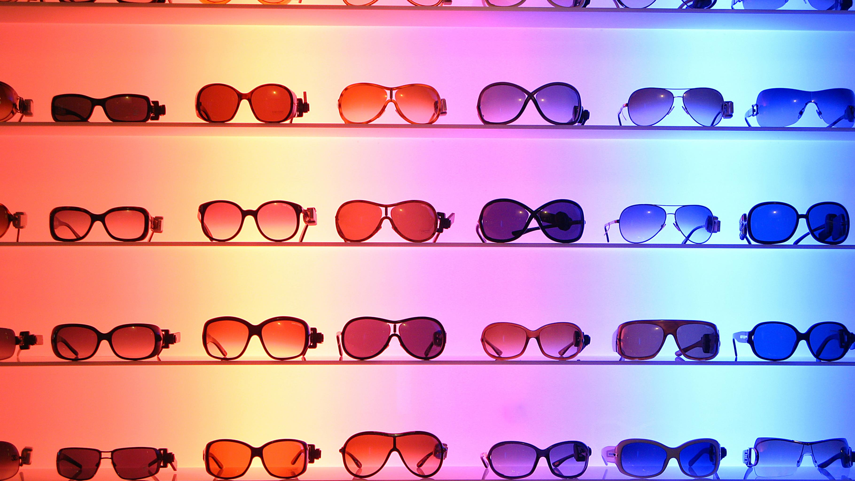
Color Glasses Project Management
By Camaleon Inc. (Fariba-Gerard-David)

Slide 2
[Project Charter] What is our Project about?
Goal: Develop glasses that can change color to match outfits and preferences.
Why is this project important? Growing demand for innovative fashion-tech solutions.
Project:
Color Glasses
Deliverables:
Functional prototype of color-changing glasses.
Mobile app for color control.
Success Criteria:
Launch product within the agreed timeline
Achieve 80% positive feedback on color features
Project Scope
Within Scope: Designing the glasses and mobile app.
Out of Scope: Long-term maintenance and AR functionality.

Slide 3



Budget:
Material costs: $50,000
App development: $20,000
Testing: $15,000
Timeline, Budget, and Risks
Key Milestones
Material research
Prototype development
App design and testing
Product launch
Risks
Technical challenges in material development.
Competition from rival brands.
App bugs affecting user experience.

Slide 4
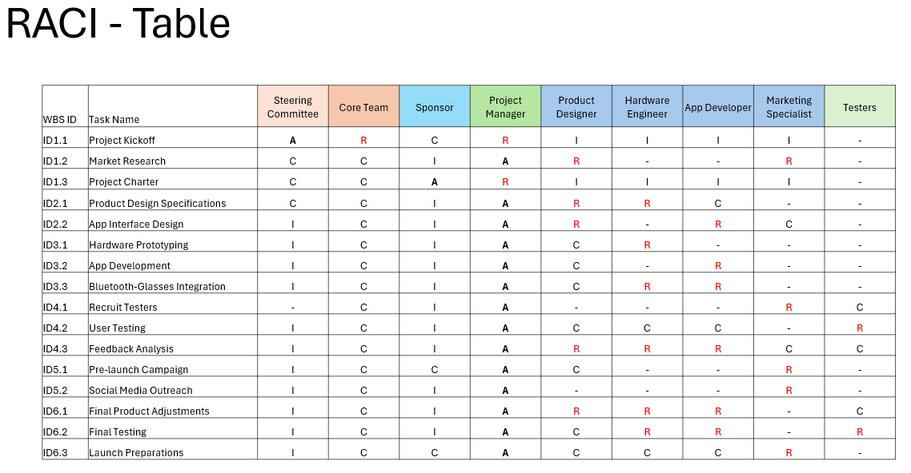
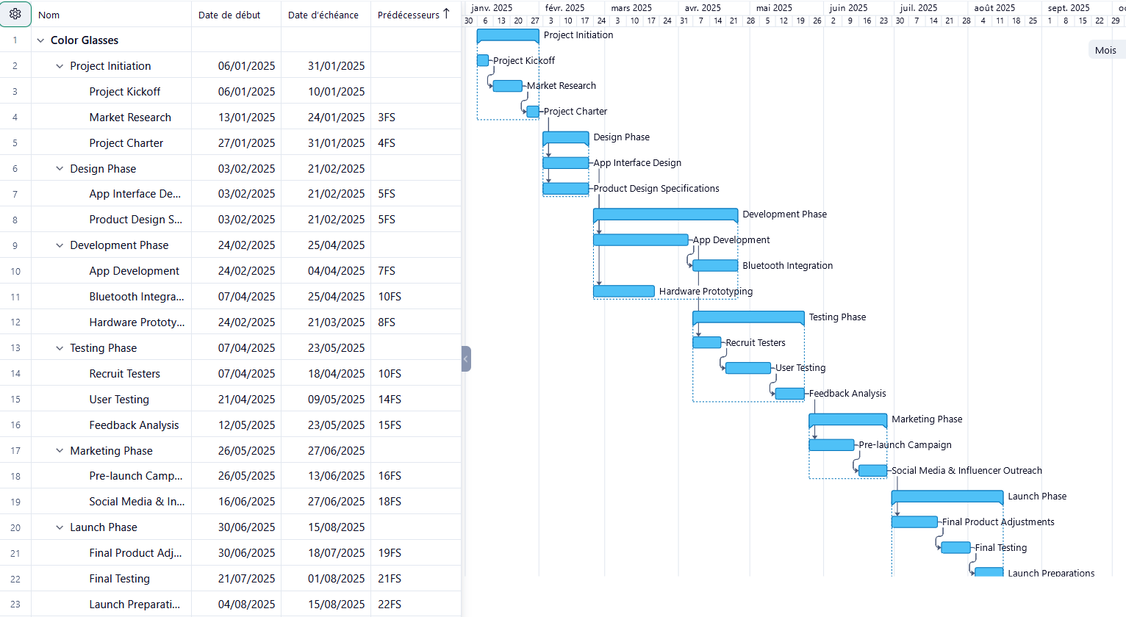


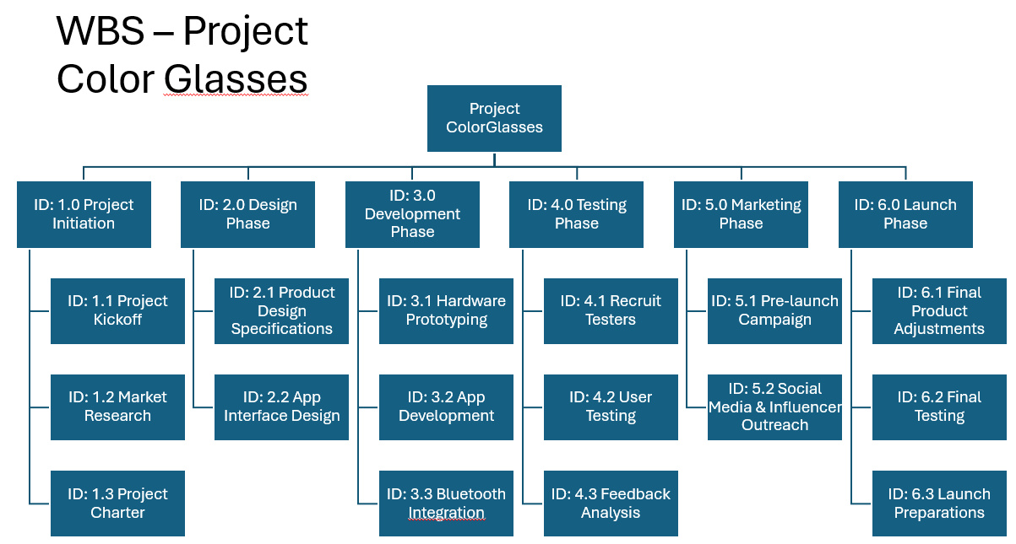
Gantt Chart
RACI
Gantt Chart
Project Management Plan
WBS
Phase-Based

Slide 5
Gantt Chart - Phases
1. Project Initiation
2. Design
3. Development
4. Testing
5. Marketing
6. Launch

Slide 6
Gantt Chart – Timeline
< 8 Months
1. Project Initiation
1 Month
< 1 Month
2. Design
3. Development
2 Months
4. Testing
< 2 Months
5. Marketing
> 1 Month
6. Launch
1.5 Months

Slide 7
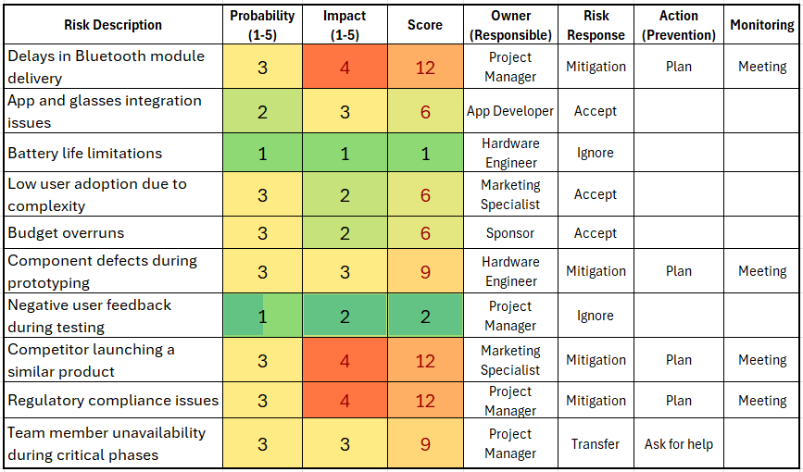
Risk Management Matrix

Slide 8

Role Play Launch in Record Time or Fall Behind!
The competition is about to strike, and David, the sponsor, demands the project launch one month early. Kra, the project manager, and Fariba, the product designer, must find a way to deliver—without breaking the budget or sacrificing quality. Can the team align expectations and rise to the challenge?

Slide 9
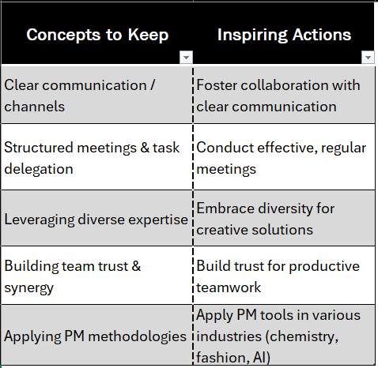
Reflexions

Slide 10

Thank you for your attention

Slide 11
Back-Up

Slide 12
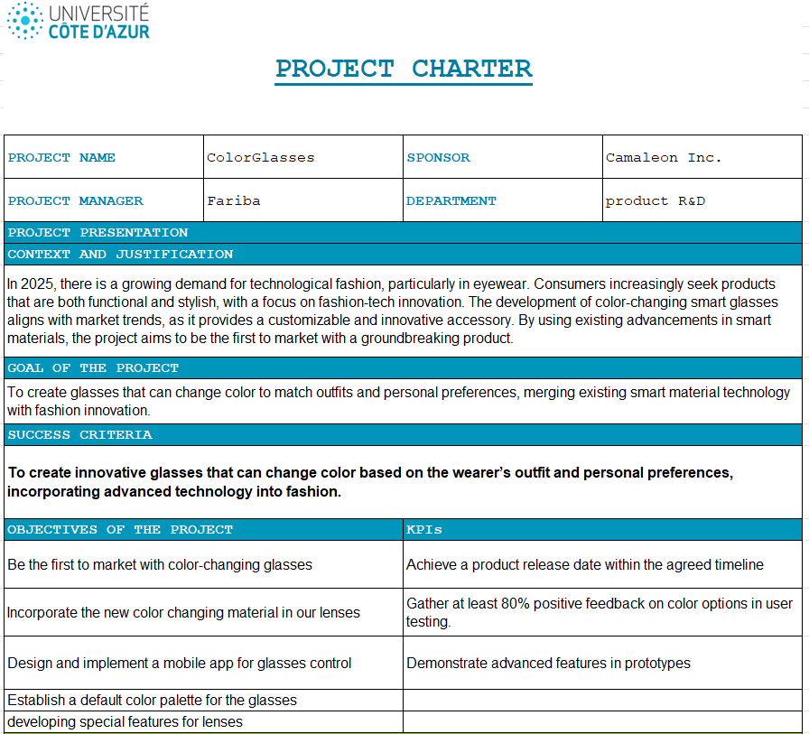
Project Charter

Slide 13
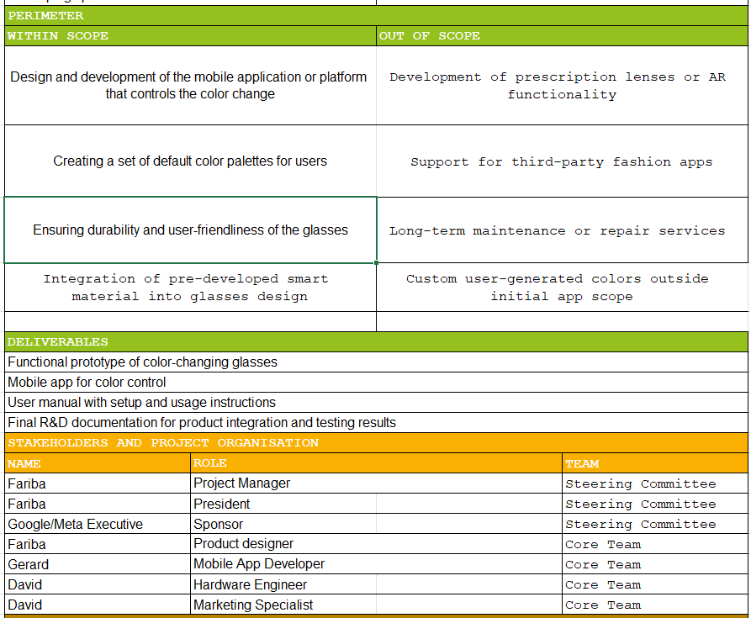

Slide 14
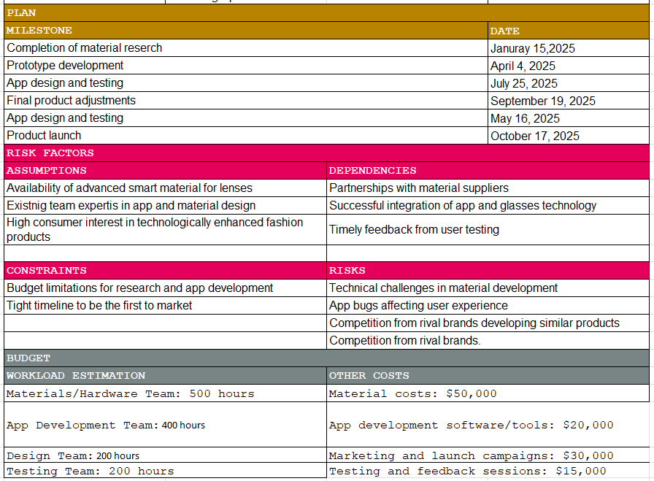

Slide 15
RACI - Table
WBS ID | Task Name | Steering Committee | Core Team | Sponsor | Project Manager | Product Designer | Hardware Engineer | App Developer | Marketing Specialist | Testers
ID1.1 | Project Kickoff | A | R | C | R | I | I | I | I | -
ID1.2 | Market Research | C | C | I | A | R | - | - | R | -
ID1.3 | Project Charter | C | C | A | R | I | I | I | I | -
ID2.1 | Product Design Specifications | C | C | I | A | R | R | C | - | -
ID2.2 | App Interface Design | I | C | I | A | R | - | R | C | -
ID3.1 | Hardware Prototyping | I | C | I | A | C | R | - | - | -
ID3.2 | App Development | I | C | I | A | C | - | R | - | -
ID3.3 | Bluetooth-Glasses Integration | I | C | I | A | C | R | R | - | -
ID4.1 | Recruit Testers | - | C | I | A | - | - | - | R | C
ID4.2 | User Testing | I | C | I | A | C | C | C | - | R
ID4.3 | Feedback Analysis | I | C | I | A | R | R | R | C | C
ID5.1 | Pre-launch Campaign | I | C | C | A | C | - | - | R | -
ID5.2 | Social Media Outreach | I | C | I | A | - | - | - | R | -
ID6.1 | Final Product Adjustments | I | C | I | A | R | R | R | - | C
ID6.2 | Final Testing | I | C | I | A | C | R | R | - | R
ID6.3 | Launch Preparations | I | C | C | A | C | C | C | R | -

Slide 16
WBS – Project Color Glasses
ID: 1.0 Project Initiation
ID: 1.1 Project Kickoff
ID: 1.2 Market Research
ID: 1.3 Project Charter
ID: 2.0 Design Phase
ID: 2.1 Product Design Specifications
ID: 2.2 App Interface Design
ID: 3.0 Development Phase
ID: 3.1 Hardware Prototyping
ID: 3.2 App Development
ID: 4.0 Testing Phase
ID: 4.1 Recruit Testers
ID: 4.2 User Testing
ID: 4.3 Feedback Analysis
ID: 5.0 Marketing Phase
ID: 5.1 Pre-launch Campaign
ID: 5.2 Social Media & Influencer Outreach
ID: 6.0 Launch Phase
ID: 6.1 Final Product Adjustments
ID: 6.2 Final Testing
ID: 6.3 Launch Preparations
Project ColorGlasses
ID: 3.3 Bluetooth Integration

Slide 17
Gantt
https://www.wrike.com/workspace.htm?acc=6622171#/folder/1530465110/timeline3?viewId=322863534

Slide 18
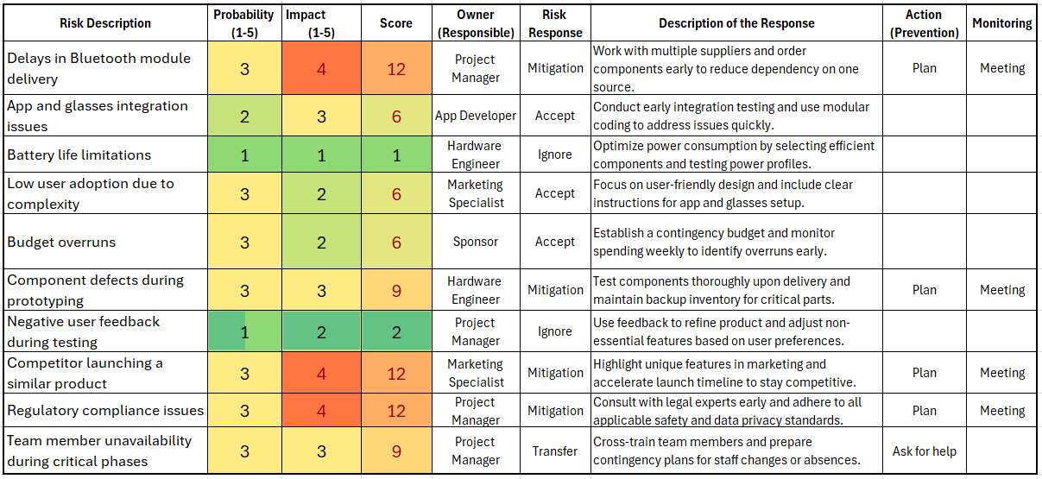
Risk Management Matrix

